Slide 1

WE'RE NOT AFRAID TO DIE...
If We Can All Be Together
By Gordon Cook and Alan East

Slide 2

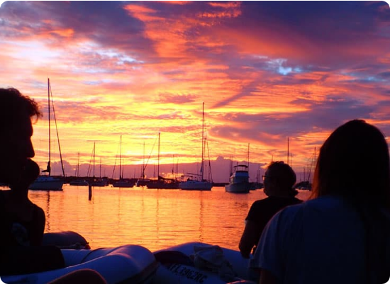
THE DREAM OF THE VOYAGE
A 37-year-old businessman and his family embark on a perilous 105,000 km journey to duplicate Captain James Cook’s round-the-world voyage.
→
The Mission: Honor the legacy of a famous explorer.
→
Preparation: 16 years spent honing seafaring skills in British waters.
→
The Team: Gordon Cook, Mary (wife), Jonathan (6), and Suzanne (7).

Slide 3






WAVEWALKER: THE VESSEL
SPECIFICATIONS
THE CREW
THE ROUTE
A 23-metre, 30-ton wooden-hulled beauty. Professionally built and tested in the roughest conditions.
Joined at Cape Town: American Larry Vigil and Swiss Herb Seigler to tackle the Indian Ocean.
Starting from Plymouth, England, sailing down the West Coast of Africa toward the Southern Indian Ocean.

Slide 4
JOURNEY
CAPE TOWN
JAN 2 DAWN
Pleasant first leg completed. Crew taken on.
Gales change for the worse. Gigantic waves.
DEPARTURE
CHRISTMAS
Ile Amsterdam
July 1976: Setting sail from Plymouth.
3,500km East of Cape Town. Wonderful holiday.
Final destination.

Slide 5
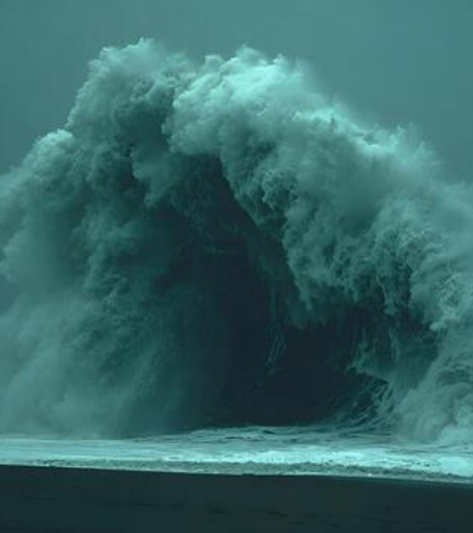
THE GIANT WAVE
JAN 2, 6:00 PM
An ominous silence followed by a growing roar. A wave like no other appeared perfectly vertical, twice the height of all others.
A tremendous explosion shook the deck. Green and white water broke over the ship, and the Captain was thrown overboard.

Slide 6

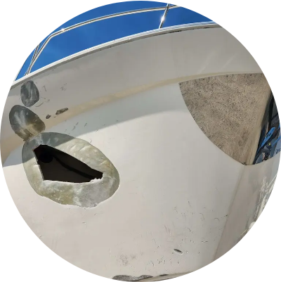
SINKING BELOW WAVES
PERSONAL TOLL
The Captain accepted his approaching death, feeling peaceful as he lost consciousness. Suddenly, his head popped out of the water.
→
Left ribs cracked; mouth filled with blood and broken teeth.
→
Wavewalker was near capsizing, masts almost horizontal.
→
Mary screams: "We're sinking! The decks are smashed!"

Slide 7

WATER, WATER EVERYWHERE
THE TECHNICAL BATTLE
HULL DAMAGE
Larry and Herb pumped like madmen. Hand pumps blocked with debris. Electric pump short-circuited.
Gaping holes were covered with canvas and hatch covers. Main rib frames were smashed down to the keel.
Fortunately, an extra electric pump was found under the chartroom floor and connected successfully.
The auxilliary engine was out of action. Australia was too far; they needed a "pinprick" island.

Slide 8
A CHILD'S RESILIENCE
“
I didn’t want to worry you when you were trying to save us all.
— Suzanne, age 7 (Upon revealing a deep cut on her arm)
Suzanne had two enormous black eyes and a swollen head, yet she chose silence to give her father strength.

Slide 9

THE ULTIMATE BRAVERY
JAN 5
JONATHAN'S RESOLUTION
"Daddy, are we going to die? ... We aren't afraid of dying if we can all be together — you and Mummy, Sue and I."
The Captain left the cabin determined to fight the sea with everything he had.
SITUATION DESPERATE

Slide 10
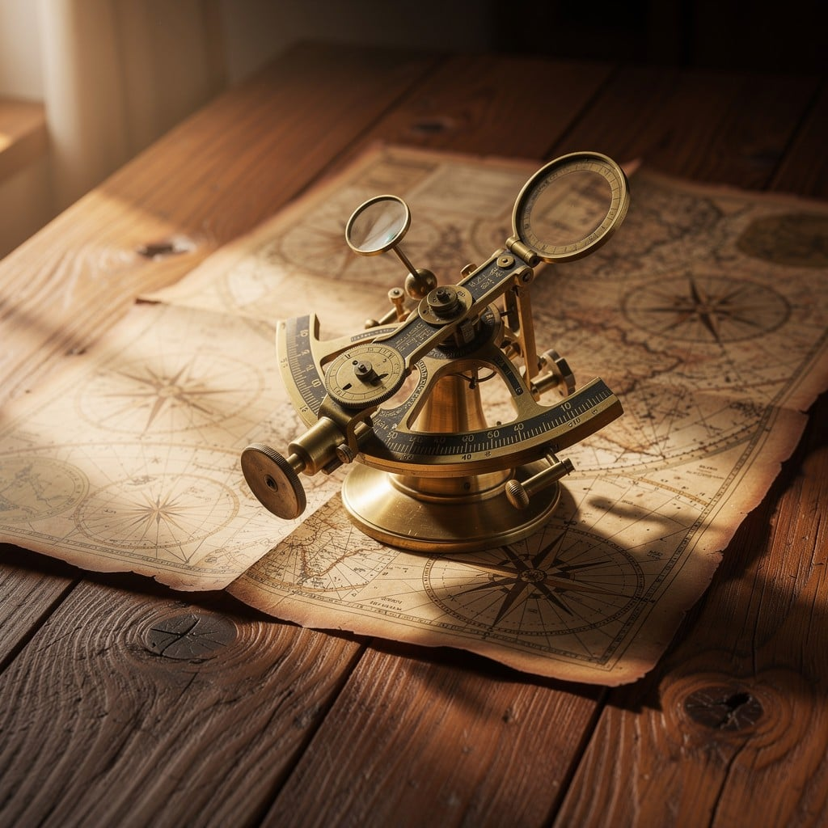
NAVIGATING THE ABYSS
POSITIONING
Calculations using a spare compass and sextant. They were in 150,000 km of ocean looking for a 65 km-wide island.
Sue gave her father a card with caricatures of her parents. "Let's hope for the best," it said.

Slide 11
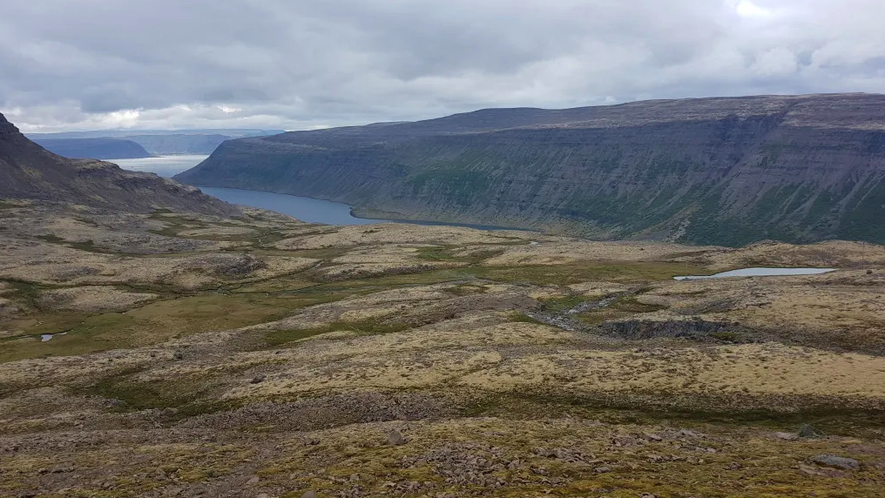
"FOUND THE ISLAND!"
Ile Amsterdam: A bleak piece of volcanic rock, yet the most beautiful island in the world.
"You are the best daddy in the whole world — and the best captain."

Slide 12

CONCLUSION
The survival of the family was not just a feat of navigation, but a triumph of spirit, optimism, and the unbreakable bond of being together.
Larry & Herb: Cheerful under the direst stress.
Suzanne: Suffered injuries without a word.
Mary: Held the wheel for crucial hours.
Jonathan: A boy who was not afraid to die.

Slide 13
THANK YOU

